Slide 1
CapstoneBall
Abdelrahman Alkhawas

Slide 2
the problem space.
research question: who would be the best option to replace Mohamed Salah next season?
other use cases:
replacing injured player
squad depth
ffp / budget problems
why? continuity

Slide 3
potential impact
leveling the playing field for smaller teams
avoiding costly mistakes for the bigger teams.
opportunities for less ‘PR’ed players

Slide 4
proposed solution
gather historical data
use model 1 to predict future seasons of players
given a player, come up with the closest resembling player

Slide 5
the dataset
7 seasons
7 categories per season
approx. 25 stats per category

Slide 6
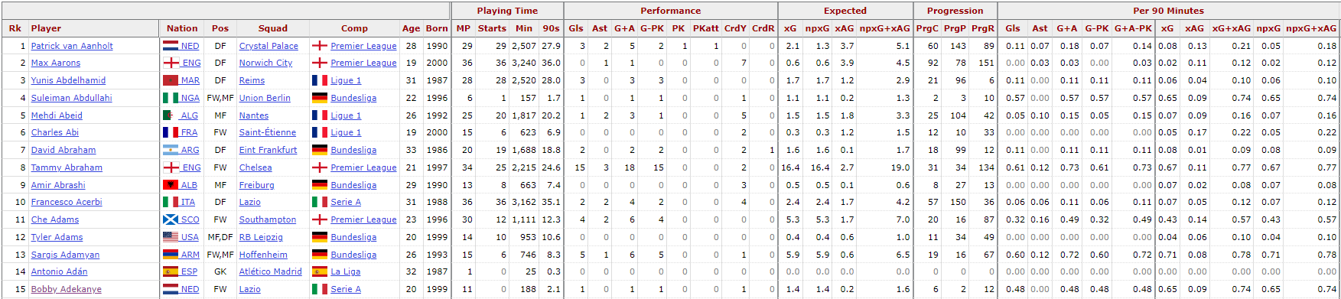
example data
player metadata
raw statistics
per 90 statistics
2019/20 standard stats

Slide 7
data processing and EDA
beautiful soup for a singular table
iterate over years and categories
clean data as it comes
end up with 49 dataframes
iterate over dataframes to concatenate them
final dataframe / csv of shape 19,564x139
missing metadata

Slide 8
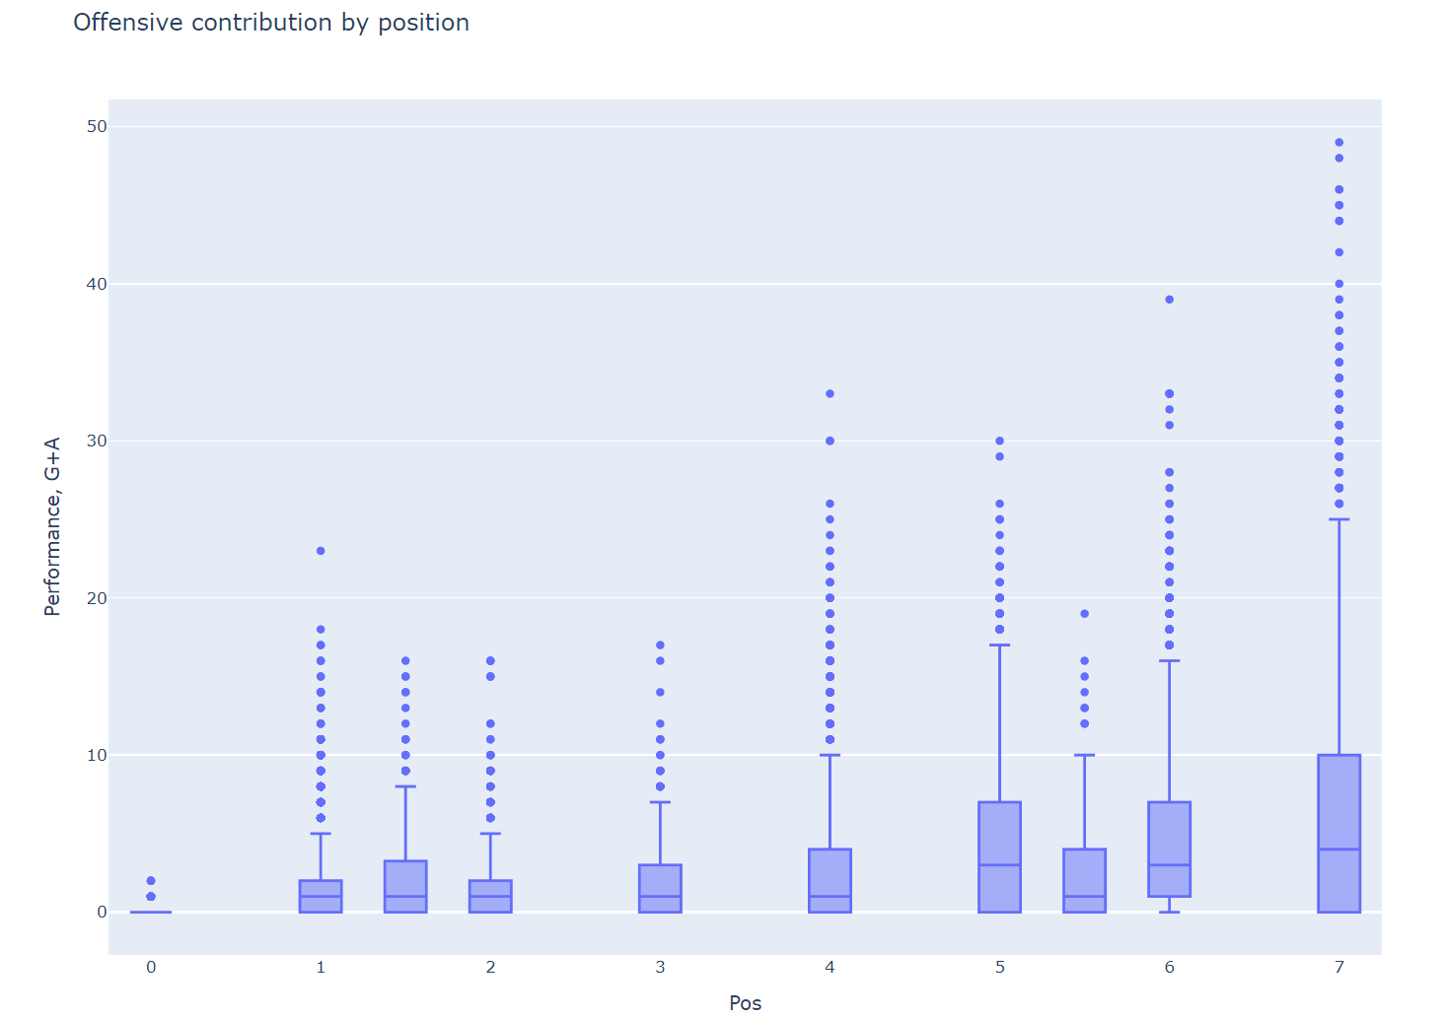
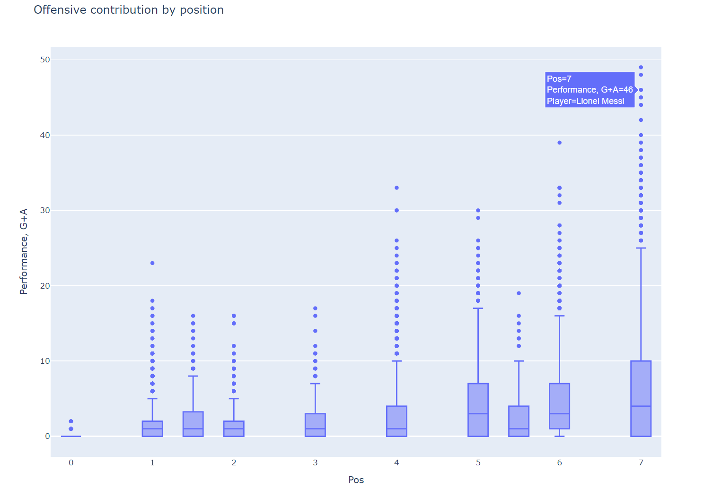

Slide 9
forwards

Slide 10
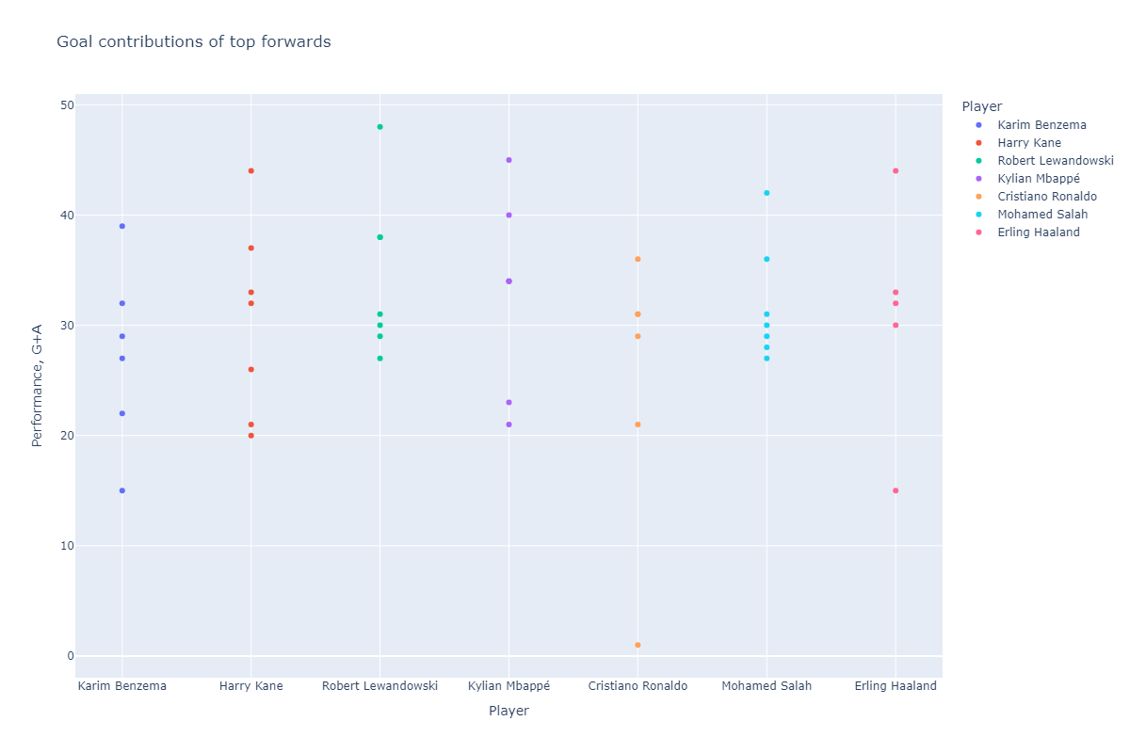

Slide 11
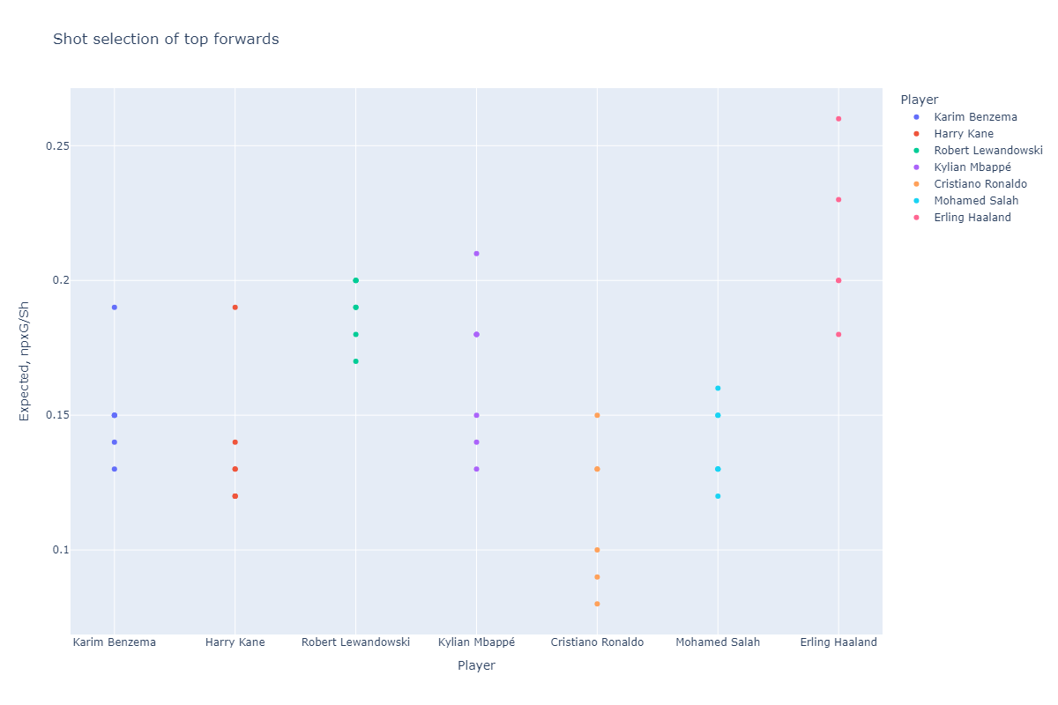

Slide 12
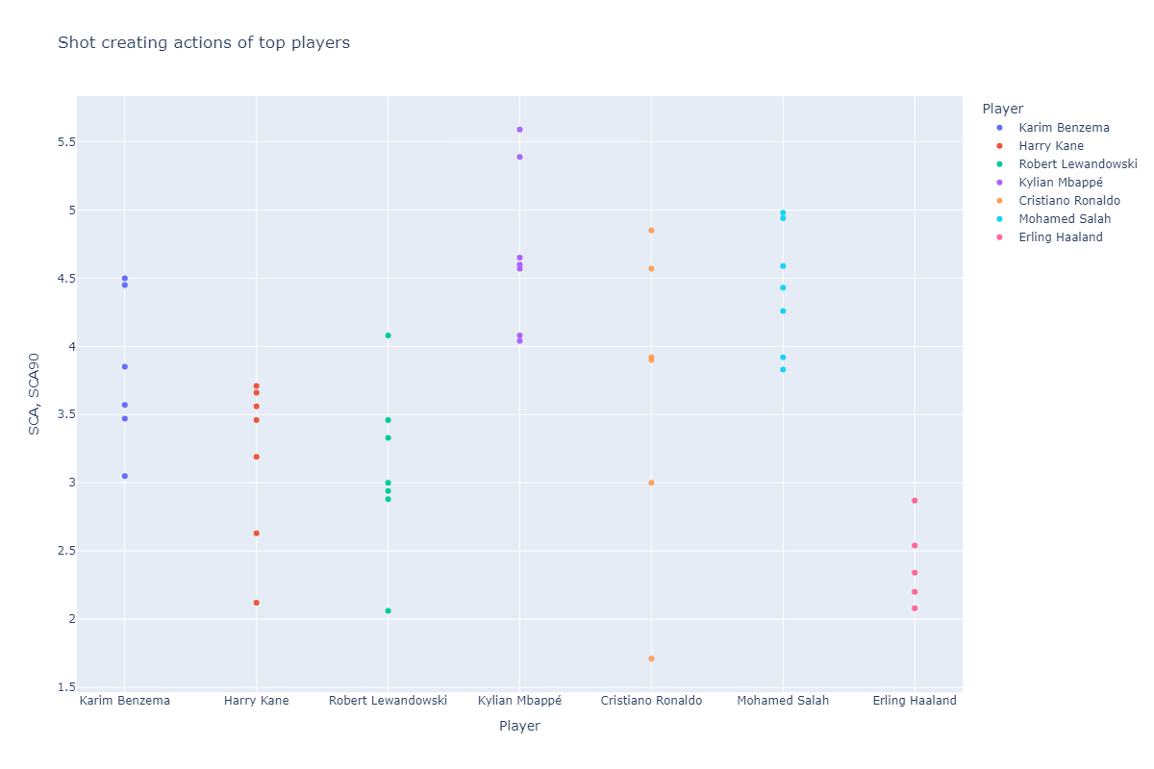

Slide 13
dribblers

Slide 14
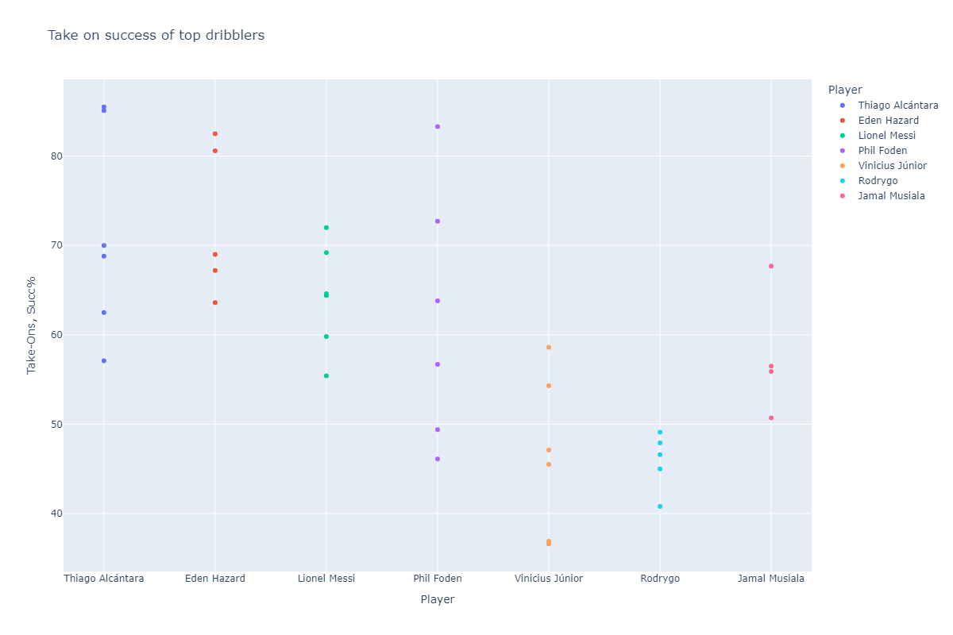

Slide 15
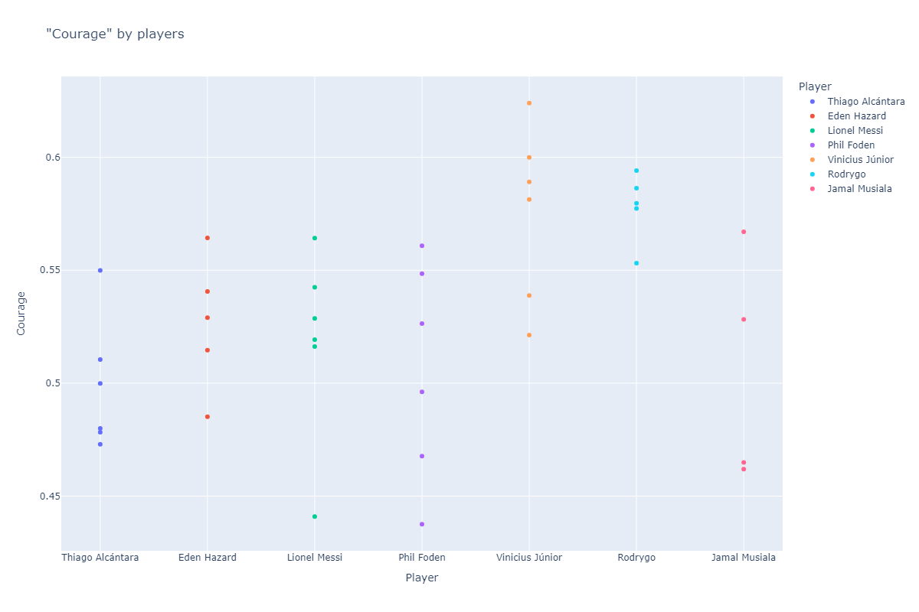

Slide 16
passers

Slide 17
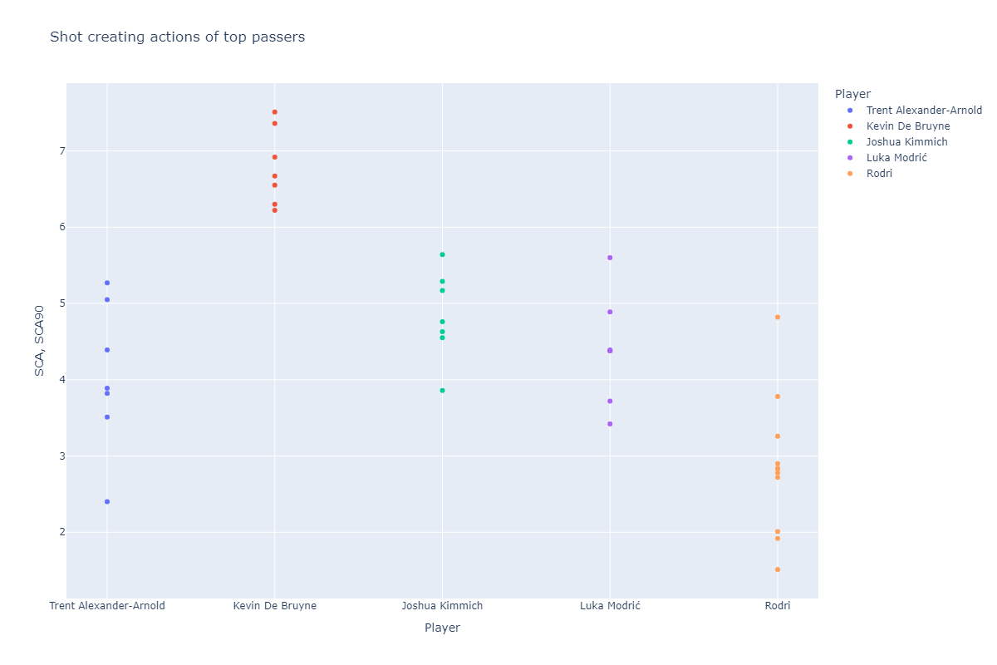

Slide 18
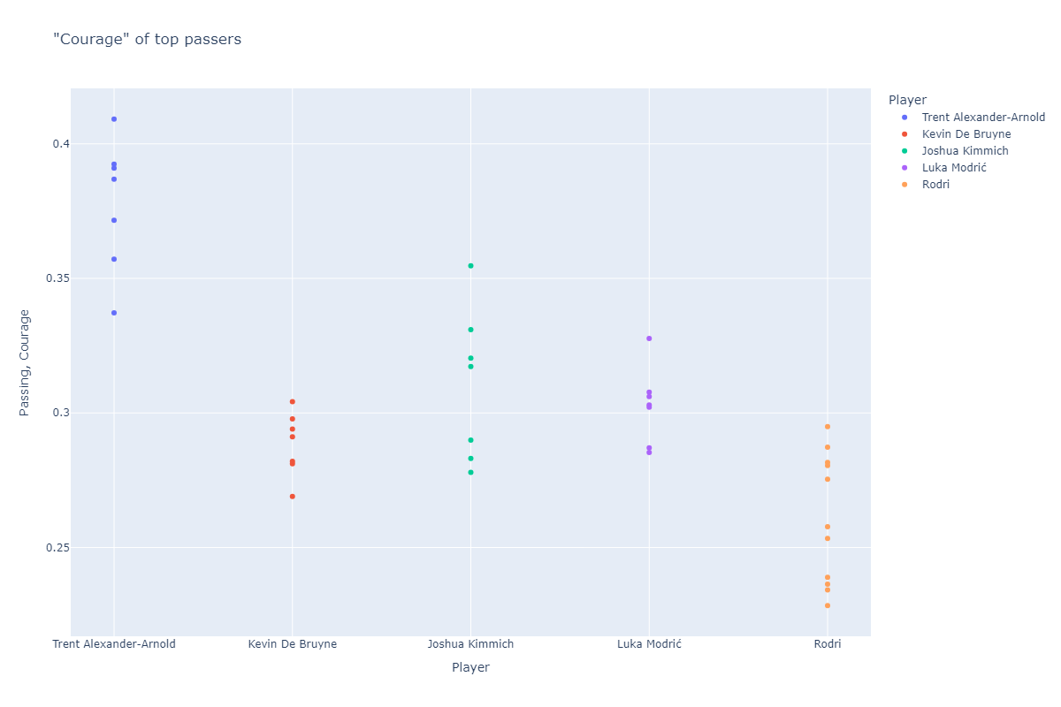

Slide 19
defenders

Slide 20
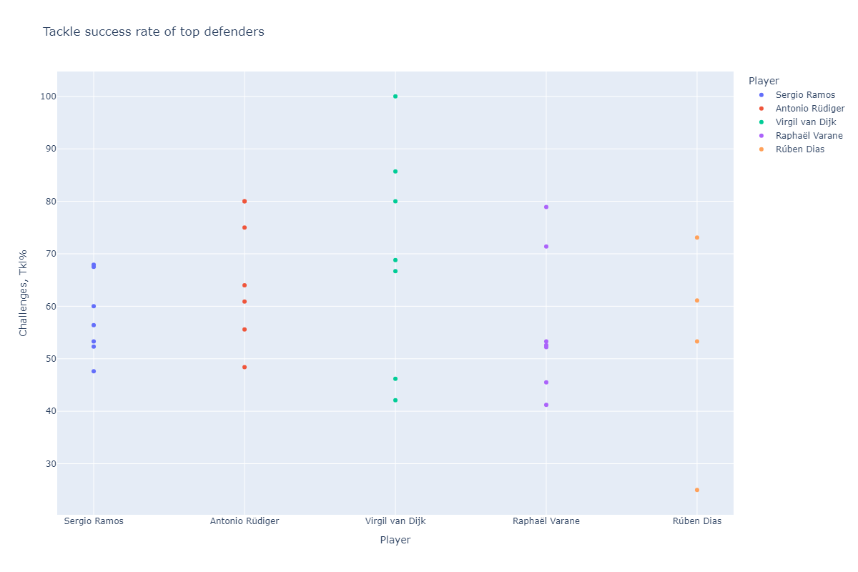

Slide 21
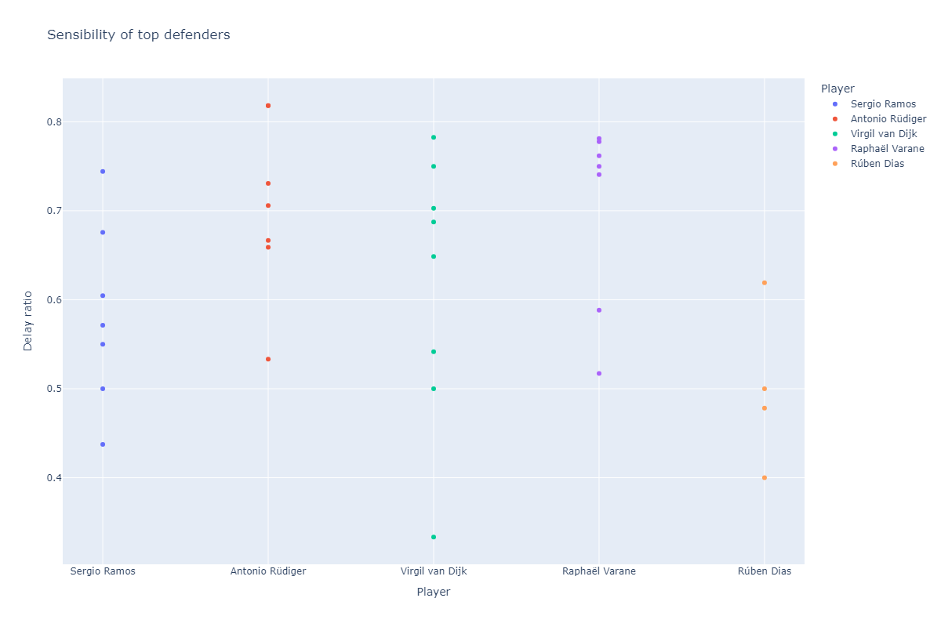

Slide 22
next steps
minimizing the number of features
formalizing similarity (e.g Trent vs KDB)
predicting the future season.

